Slide 1
S-100 Validation Tests sub group
11th VTC Meeting
15th January 2025

Slide 2
Meeting protocol
Meeting participants are kindly requested to note the following meeting protocols;
Please keep your camera and microphone turned “off” if you are not talking or presenting
If you want to make an intervention, please turn your camera and microphone on and, raise your hand to indicate that you wish to speak
Don’t forget to turn your microphone “on” before speaking, and “off” when finished
Please use the “Chat” function to communicate an text information to the meeting
If you have any problems connecting using Firefox or other browser – please try using Chrome.

Slide 3
AGENDA
Feedback from S-100 WG 9
Status on S-158:100 & S-158:98, out for comment until 15th January
Status of cross product validation VTCs
Classification of validation checks
Review of feedback received so far
Next steps

Slide 4
S-100 WG 9 feedback
Held 2 hour session
Discussed the issues highlighted at October 24 VTC and asked for approval on these items
General discussions throughout the week regarding Data Quality and Data Validation Checks
Data Quality – how verify the content (verification)
Data Validation Check – how check the dataset will work (validate)

Slide 5

S-100 WG 9 feedback – 15 decisions/Actions
Data Quality
Decision 9/01: Agree to leave the DQ Measures in the check template but make it optional
S-100 ValSG lead to invite DQWG Chair elaborating a use case the DQ column in the validation checks.
DQWG Chair had provided significant feedback asking for Validation checks to be reorganised by DQ Measures – will not implement and retain existing structure

Slide 6
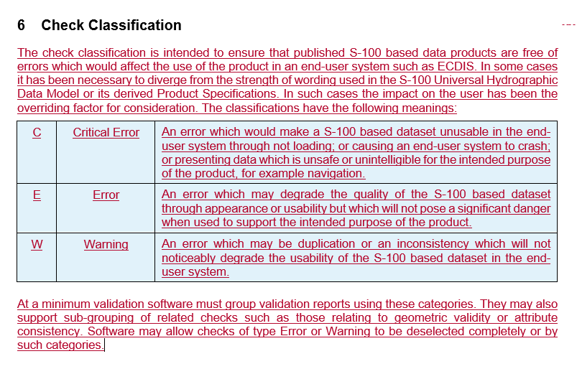
S-100 WG 9 ACtION/DECISIONs
Check Classification
Decision 9/02: Agreed to use Check Classification for conformity with other standards
Decision 9/09: Agreed to use the S-58 Classifications for now as it is and Liz/Jeff to amend the S-58 wording for S-158:100
Jeff has provided rewording to make descriptions less ENC specific
Question over non-nav products but Phase 2 issue
Will return to later in VTC

Slide 7
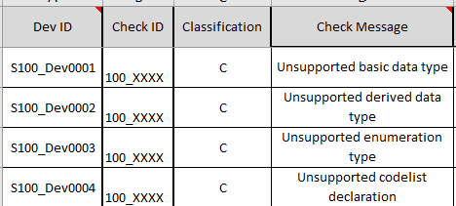
S-100 WG 9 ACtION/DECISIONs
Check ID naming convention
Decision 9/03: Agreed to remove the S- in front of the naming convention for CheckID
This will be for all S-158 documents, so PS validation checks as well
Documentation has been updated
Dev IDs will stay the same, with the S until removed from S-158

Slide 8
S-100 WG 9 ACtION/DECISIONs
Metanorma
Decision 9/04: Noted that S-100WG/Secretariat to discuss use of Metanorma more formally with HSSC.
Push to move to document creation on Metanorma
There is never a good time, but there can be a bad time
Will review after Edition 1.0.0 is published
S-102 may adopt S-158:102 in Metanorma and then we can use their template

Slide 9
S-100 WG 9 ACtION/DECISIONs
Format of checks & documents
Decision 9/05: Agreed that S-158:1xx cover document will be delivered in Word and Validation Checks in Excel to the S-100PS owners.
Decision 9/13: Validation subgroup to submit a paper on possibilities for future storage of validation checks (S-100WG10)
Will discuss at a later VTC
The template structure was approved

Slide 10
S-100 WG 9 ACtION/DECISIONs
Handover
Decision 9/06: Approved the S-158:101 checks and will be sent to HSSC for approval.
Accept there will be will potentially be an overlap between S-101 and S-100 validation checks, will likely be new versions very quickly
S-158:101 has now been signed off by HSSC CL
Decision 9/07: S-100 Validation Checks subgroup can handover the S-158:1xx checks to the S-100PS owners, who then take on responsibility to update checks.
Have been handed over to S-102, S-104, S-111, S-124 & S-129 in Nov/Dec
It is PT responsibility to maintain, ensure up to date, remove duplicates with S-100 checks and publish

Slide 11
S-100 WG 9 ACtION/DECISIONs
Maintenance
Decision 9/08: Validation Checks subgroup to produce a proposal form (similar to S-100 proposal form) for changing validation checks, to be shared with S-100PS owners
Light touch from S-100 validation sub group as is each groups responsibility, but to provide a basic framework
Will schedule for work after HSSC

Slide 12
S-100 WG 9 ACtION/DECISIONs
Publication of S-158:100 & S-158:98
Decision 9/10: Agreed to publish Edition 1.0 of S-158:100/98 to (Implementation version) HSSC 17
Draft ready December 2024
Final ready February 2025 – working on now
Submission to HSSC 17 (submit after TSM in March)
Implementation version means we can make changes up to Edition 2.0.0 within S-100 WG. Expect will publish Edition 2.0.0 quite quickly
Does mean that the Operational versions of PS will be referring to Implementation versions of S-100 Validation checks
Decision 9/11: Validation subgroup to add wording to S-158:1xx explaining versioning

Slide 13
S-100 WG 9 ACtION/DECISIONs
Part 6 - Coordinate Reference Systems
Decision 9/12: agree to remove from S-100 level and to include in S-98 validation checks
S-100 standards vs. dataset checks
Decision 9/14: S-158:100 agreed to use separate sections to register dataset checks and generic standards/framework checks.
Consider moving standards checks to S-97 in the future.
Checks now separated into Collection A & Collection B

Slide 14
Cross product Validation vtcs
Cross product validation
S-100ValSG with Working Groups & PTs to arrange VTCs for Water Level Adjustment (S-101, S-102 and S104) and in January 2025 for the S-124 and S-129 validation.
S-101, S-102, S-104 & S-111 met 9th December
Primarily led to changes to S-98 which will then be reflected in the validation checks when the draft is ready
No holes (grid square) in S-102 unless the underlying S-101contains a LNDARE or UNSARE
Scale appearance
Uncertainty
Use of projected/unprojected and mixed projection data
Liz to contact S-129 & S-124 regarding whether a VTC is necessary or whether can be completed by correspondence

Slide 15
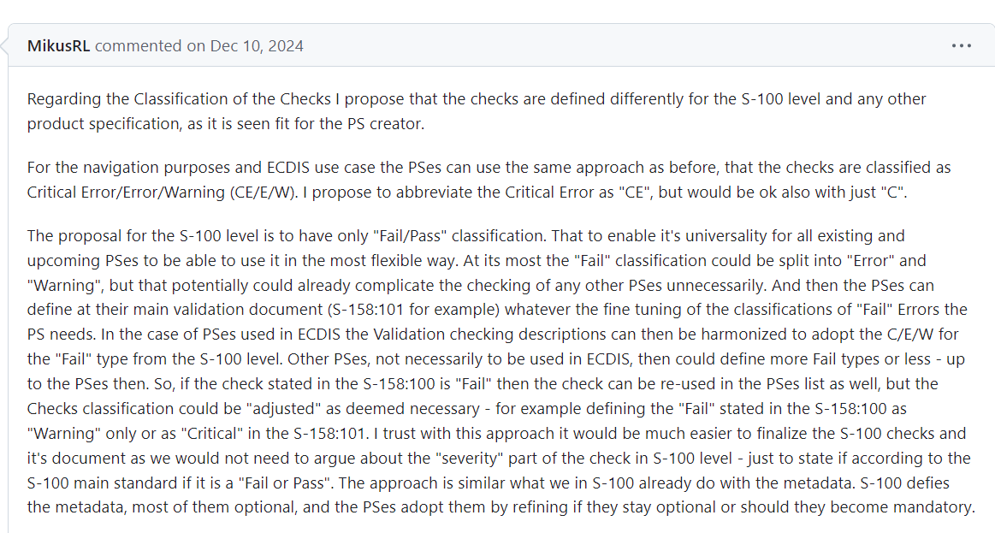
Classification of validation checks
GitHub Issue #71
Propose:
Discuss in group if this is something we wish to pursue
If yes, need to submit a paper to S-100 WG to change (I suggest TSM)
When could change be applied?
Realistically for edition 2.0.0
Will need resources to complete the work
Note: we are only looking at ECDIS use products at this stage

Slide 16
Review of feedback received so far
Received feedback from Australia, Frank Hippmann, Jeff (IHO) & NTOU
Raphael has continued to work on the checks while on review so have his proposed changes as well

Slide 17
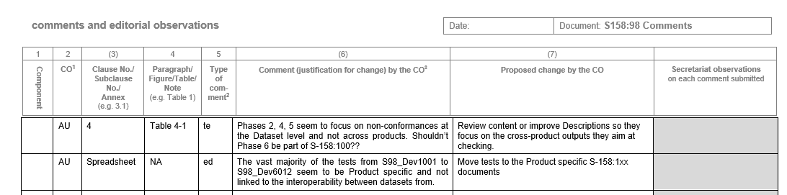
Australia feedback – S-158:98
Proposed responses:
TBD after deletion of product-specific checks (see other AU comment). Might leave in table with a remark about there being no checks in the phase. S-98 is still under development and checks might turn up later.
Agree to remove product-specific checks

Slide 18
Next steps
Review and incorporate feedback
Continue producing a set of tests from Parts of S-100 and cross product checks
Refining some of the S-100 level checks delivered from S-101 (Part 1)
Coordinate Cross-Product Validation with S-98/S-164 lead, DQWG and S-1xx PS owners
Draft of S-98 due at the end of January
Second release of S-158:100 & S-158:98 in February
Incorporate feedback from circulation
Following TSM in March submit to HSSC 17 via S-100 WG

Slide 19
Next meetings
S-100 TSM 11, Monaco – 25-28th March
Suggest next VTC meeting is March before TSM

Slide 20
Any Questions?

